Slide 1

Market Mix Model
IPBA Batch 8 - Group B
Group Members:
Garishma Jaiwal
Nikhar Oza
Kartikey Srivastava
Mitesh Shetty
Pallabi Banerjee
Pooja Rokade
Punit Jha
Sumit Panda

Slide 2

Problem Statement
Develop a market mix model for Eleckart for top sub-categories to observe the impact of different marketing levers over the last year
About the Business
ElecKart is an e-commerce firm based out of Ontario, Canada specializing in electronic products. Over the last one year, they had spent a significant amount of money on marketing. Occasionally, they had also offered big-ticket promotions (like the Big Billion Day). They are about to create a marketing budget for the next year, which includes spending on commercials, online campaigns, and pricing & promotion strategies. The CFO feels that the money spent over the last 12 months on marketing was not sufficiently impactful, and, that they can either cut on the budget or reallocate it optimally across marketing levers to improve the revenue response.
.
Notes:
Two Key Points Text Picture Active happy

Slide 3
Data Understanding
Paste Slide from Sumit

Slide 4

Data Availability & Understanding
PRODUCT
PRICE
TIME
PROMOTION
1
2
3
4
Marketing Investments
Discounts
#units sold
Sub-Category Level details
Delivery dates & SLA
Product procurement SLA
Payment Type
GMV
Product MRP
Weekly level sales data
Monthly level Investment data
Holiday Event
Salary day Event
Notes:
Agenda pictures

Slide 5

Data Preparation Steps
Leveraged KNIME Platform to do the following data cleaning process
Dropping insignificant variables
Handling incorrect values for some columns
Stitching Main Dataset with Investment data
Aggregating dataset at sub-category level
Dropped columns (‘deliverybdays’, ’deliverycdays’) with single unique values
Dropped columns that were insignificant to the analysis (‘pincode’, ‘cust_id’)
Treating incorrect GMV values (where gmv > product_mrp * units) by imputing the faulty MRP values with GMV/units
Handling Negative values for SLA & procurement_sla
Handling large values(0.3%) for SLA & procurement_sla by dropping them
Joined Investment level dataset with main dataset by assigning the dollars basis the date_frequency and no.of days sales are done for that product
Joined Holiday data and Salary day data with main dataset
Grouped by data at Sub-category level
Treating NULL values
Select one Year of data
Calculated new fields
Outlier Treatment
Calculated gmv/unit = gmv/units
Calculated Discount = (product_MRP-gmv_per_unit)/product MRP
Calculated Value = product_MRP*units
CAPPED the values above 90 percentile to the value corresponding to 90 percentile for SLA and procurement_sla
Capped GMV values between 25-75 interquartile range
Dropped rows from dataset where gmv and unit values were NULL
Dropped rows for May-June 2015 and July 2016 since rows were very less for these months. Analysed only 1 year starting from July 2015 till June 2016

Slide 6
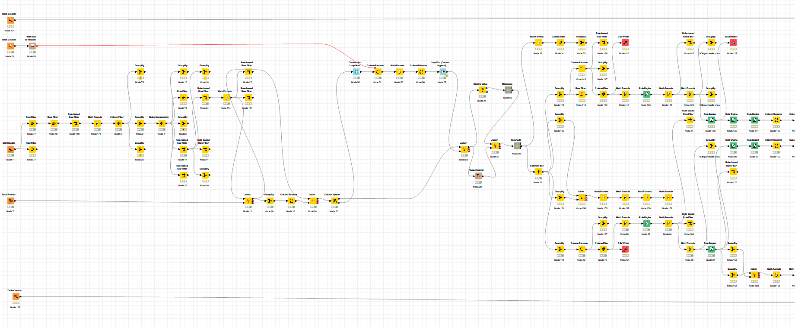
Snapshot of KNIME Workflow

Slide 7
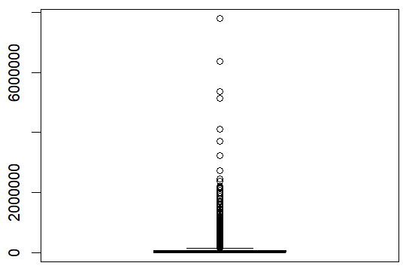
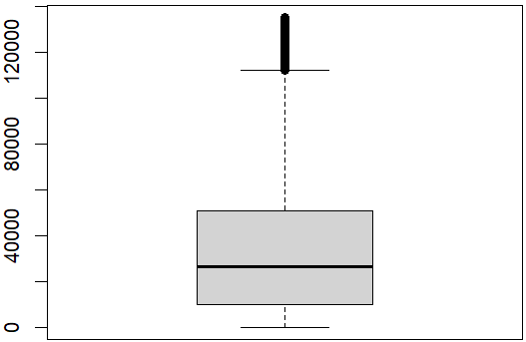
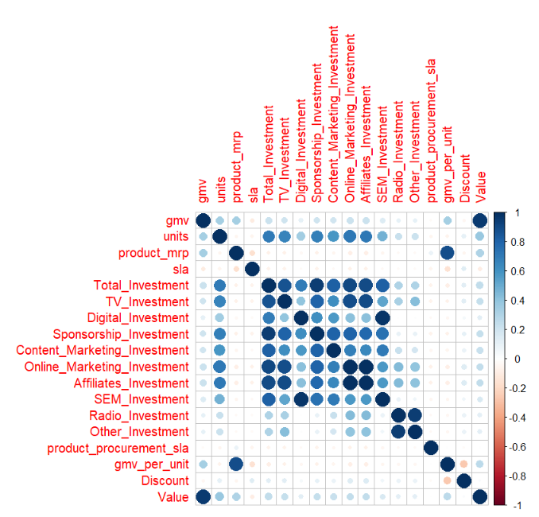
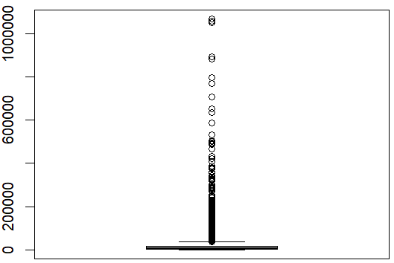
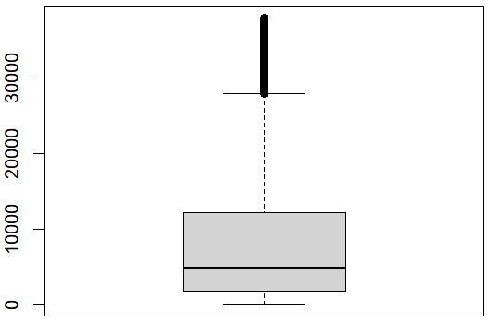
Snapshots of outlier treatments and Correlation Plot
Camera:
Paste Images from R
Before outlier Treatment
After outlier Treatment
Speaker:
After outlier Treatment
Before outlier Treatment

Slide 8
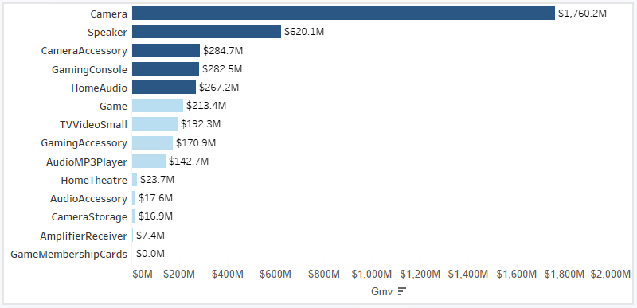
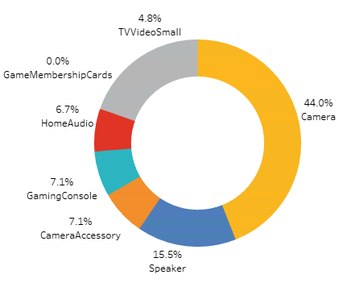
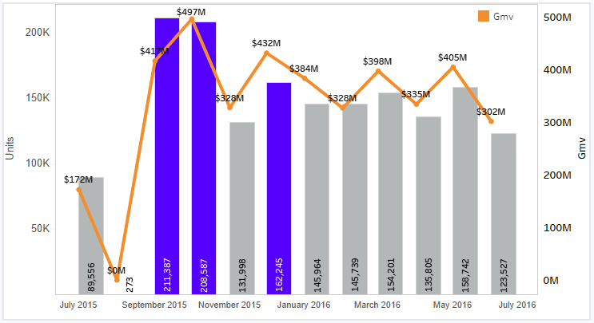
Exploratory Data Analysis
Camera, Speaker, Camera Accessory, Gaming Console and Home Audio are the top sub-categories contributing 80% of GMV sales. Built 5 different models to identify the significant variables and investment types.
Highest revenue is generated in the month of September, October and December

Slide 9
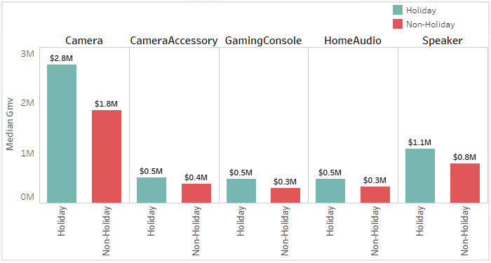
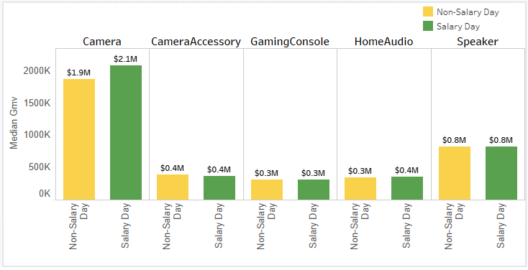
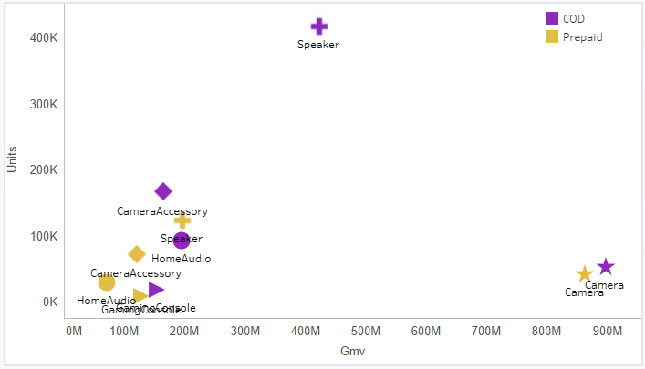
Exploratory Data Analysis
Products sold on COD sell more in general and bring in more revenue.
Speakers sold on COD contributes largely to the category units followed by Camera Accessories
Revenue generated during Holidays is above par as compared to during Non-holidays
Revenue generated by Camera is highest during holidays as compared to other categories
Revenue generated during Salary Day is almost at par as compared to during Non-Salary day

Slide 10
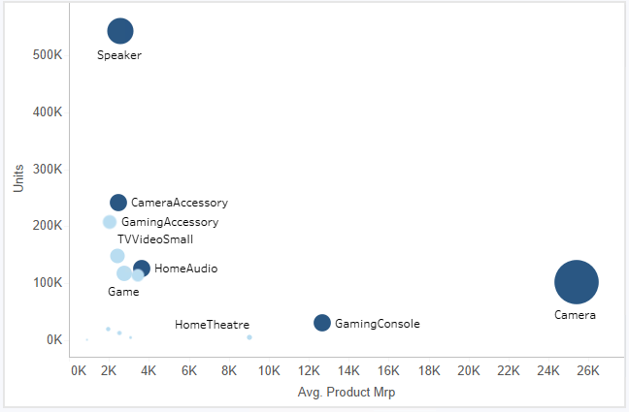
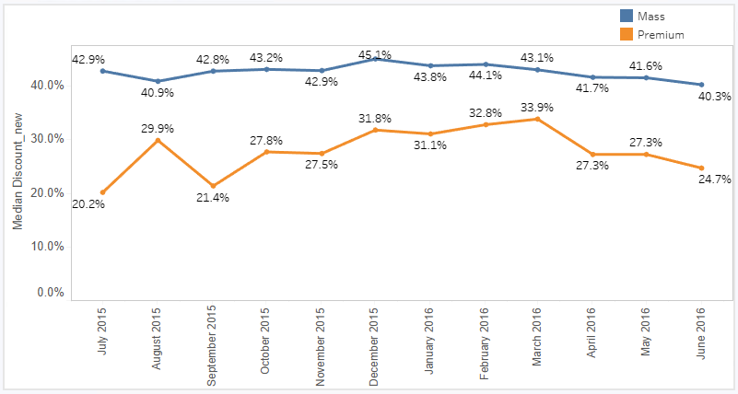
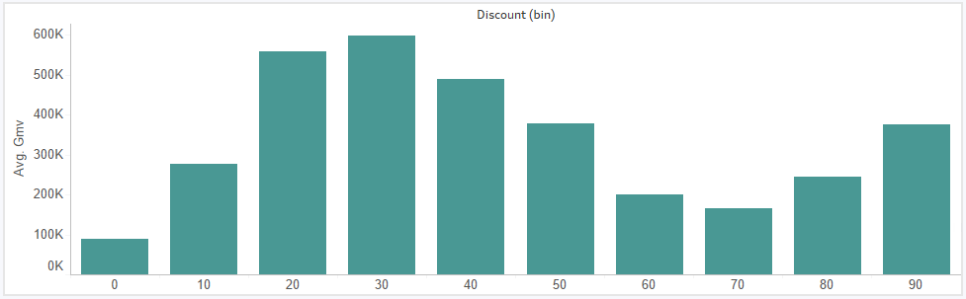
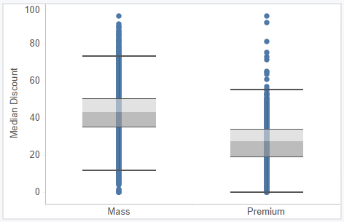
Exploratory Data Analysis
Camera is the highest priced product followed by Gaming Console
Higher discounts are given for Mass products of approx. 41%-45% as compared to Premium products which is in the range of 25%-30%
On an average, Revenue is maximum when discount % is between 20-40%. Beyond that average revenue slowly starts to decline
The median discount percentage offered for premium items is less compared to that of mass products.

Slide 11
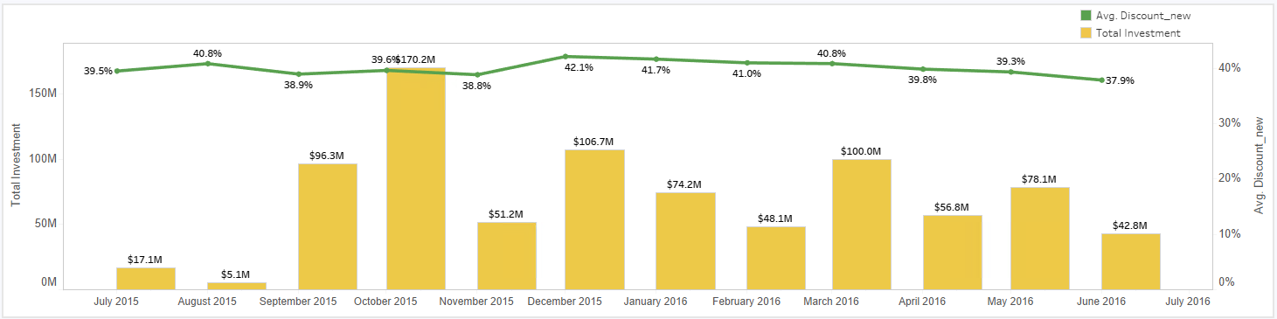
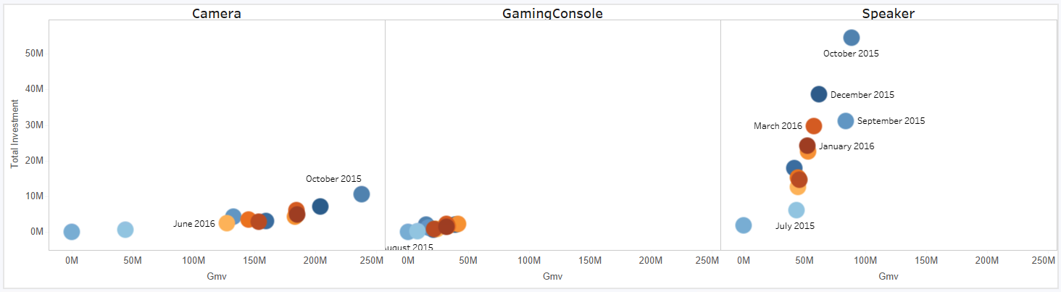
Exploratory Data Analysis
Highest investments made in the month of October which results in yielding higher revenue. Highest discounts is given in the month of December because of festive seasons
Total Investment comparisons across categories

Slide 12









Model Building Steps after EDA
10. Model Accuracy
Check the model accuracy by calculating RMSE
9. Predict Test dataset
Use the model to predict using test dataset
8. Model Assumptions
Check for model assumptions by checking for normality and plotting residual plots
7. Predict yhat
Predict yhat using predict() on the train dataset
6. Multi - Collinearity
Check for VIF values and keep on eliminating the variables that show high multicollinearities till we get VIF values less than equal to 5 till we get to the final fitted model
5. AIC Model
Build an AIC model using null and full model using forward selection method
4. Normalization
Normalize the train and test datasets using MinMax Scalar methodology
3. Split Dataset
Split the entire dataset into 5 categories for building 5 different models and divide the dataset into train and test split
2. Factor Variable
Convert the categorical variables into factor variables and check for correlation plot
1. Import Dataset
Import libraries and the output of KNIME module in csv format into R

Slide 13
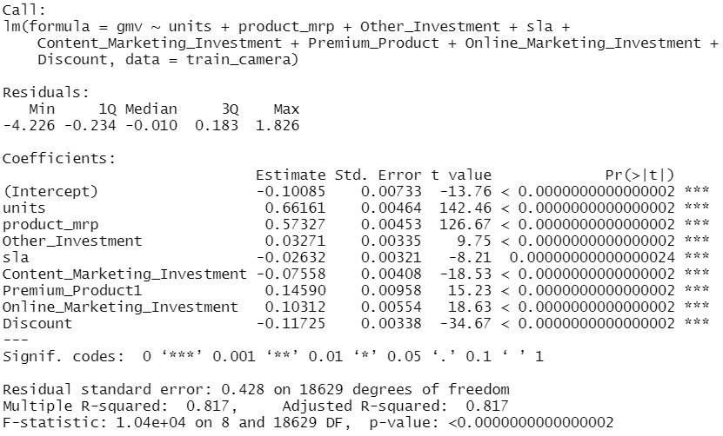
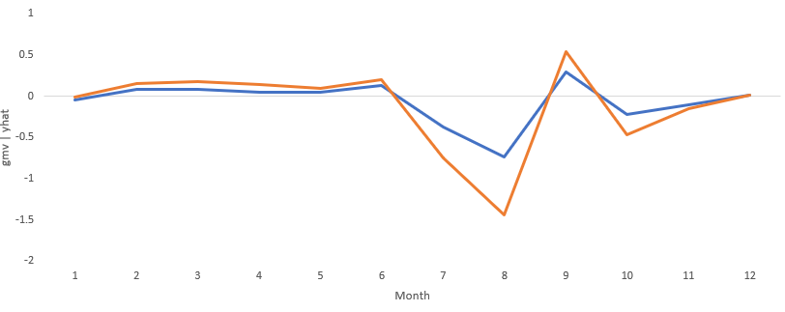
MLR - Camera
5 different MLR models are built for 5 sub-categories to determine important KPIs that influence the revenue growth.
Model 1 Camera
fit_camera_3 = lm(gmv ~ units + product_mrp + Other_Investment + sla + Content_Marketing_Investment + Online_Marketing_Investment + Discount + order_payment_type, data = train_camera)
Model Results:
Comparison of Actuals vs. Predicted (GMV)
Adjusted R Square: 0.81
RMSE : 0.4286

Slide 14
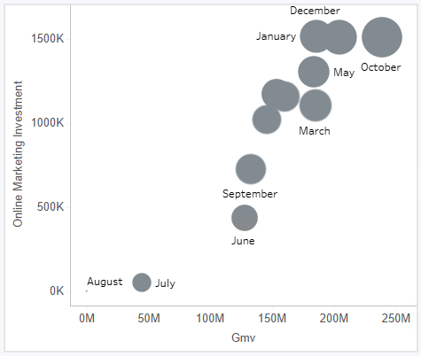
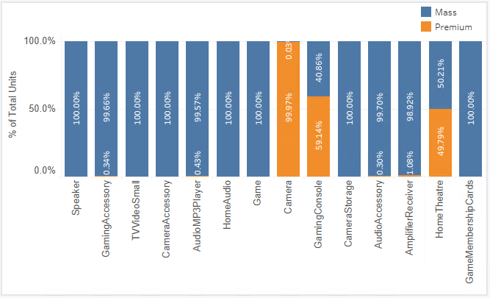
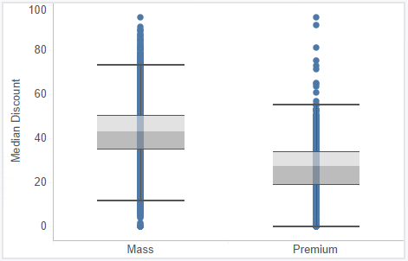
Recommendation - Camera
Model 1 Camera
fit_camera_3 = lm(gmv ~ units + product_mrp + Other_Investment + sla + Content_Marketing_Investment + Online_Marketing_Investment + Discount + order_payment_type, data = train_camera)
Online Marketing is causing a positive impact on the overall revenue for Camera
One dollar increase in Online Marketing investment will result in increase of revenue by 0.103 dollars
Content Marketing on the other hand is causing a negative impact on the revenue growth. The investments made to content marketing should be re-considered to shift the dollars to online marketing investment type.
Investment
Since Camera is a premium category, Discounts given for Camera are not working well for revenue growth
Discounts offered has a positive impact only for Mass categories
Price
SLA
One unit increase in SLA shows a decrease in revenue by 0.02 dollars
Notes:
Three Key Points Comparison Text Blanc

Slide 15
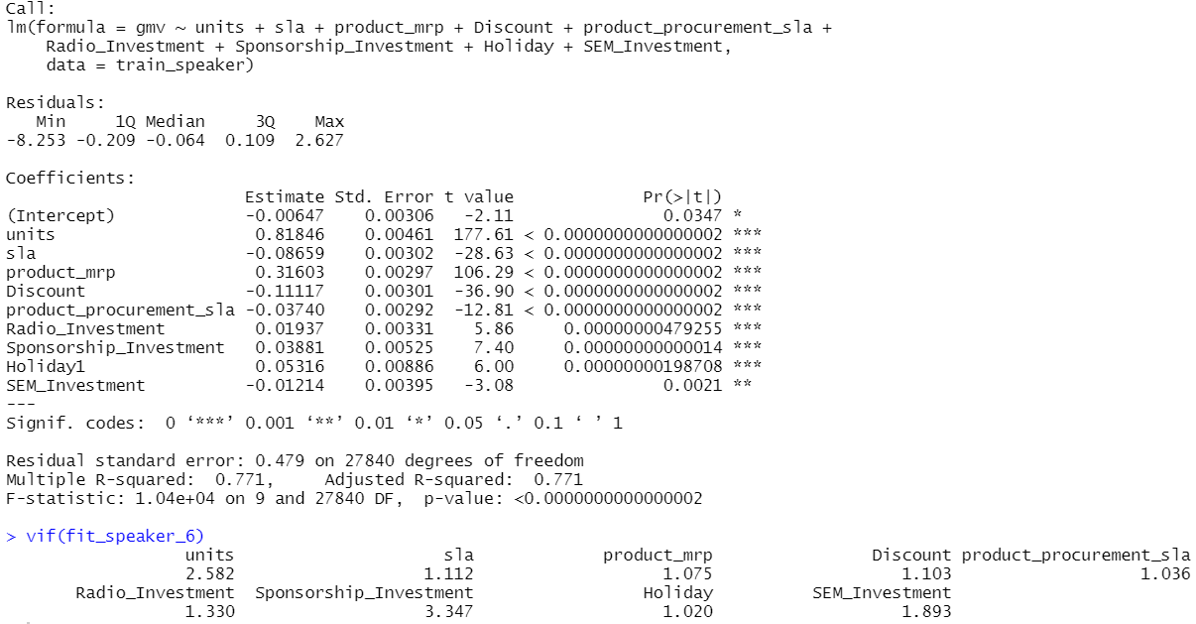
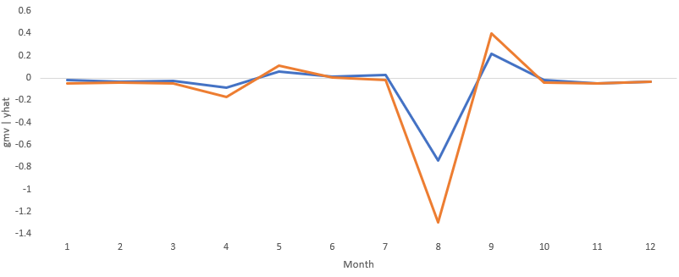
MLR - Speaker
Model 2
Speaker
fit_speaker_6 = lm(gmv ~ units + sla + product_mrp + Discount + product_procurement_sla + Radio_Investment + Sponsorship_Investment + Holiday + SEM_Investment, data = train_speaker)
Model Results:
Comparison of Actuals vs. Predicted (GMV)
Adjusted R Square: 0.77
RMSE : 0.4785

Slide 16
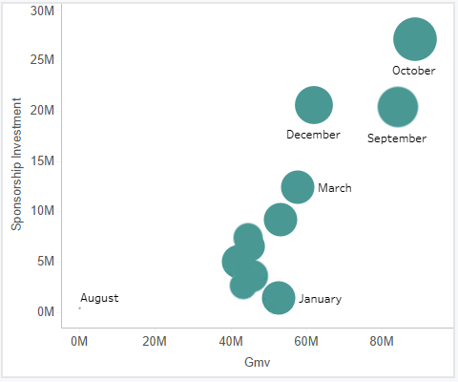
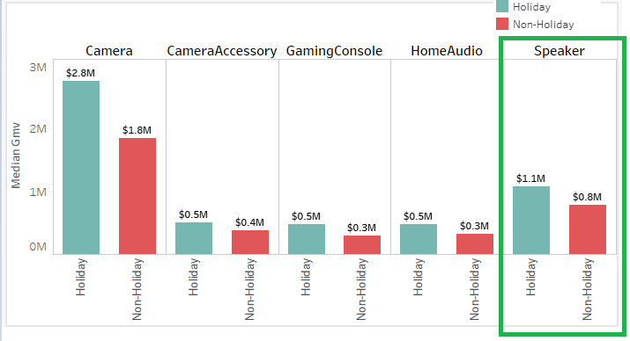
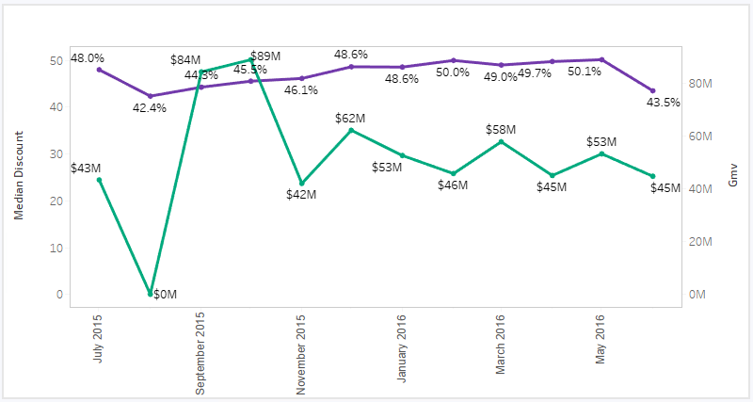
Recommendation - Speaker
Model 2 Speaker
fit_speaker_6 = lm(gmv ~ units + sla + product_mrp + Discount + product_procurement_sla + Radio_Investment + Sponsorship_Investment + Holiday + SEM_Investment, data = train_speaker)
Investment
Sponsorship Investment is creating +ve impact on the revenue growth. With a unit dollar increase in Sponsorship investment, we get a revenue growth of 0.028 dollars
SEM Investment on the other hand is negatively impacting the revenue. Actions steps to re-invest SEM dollars
SLA
& Holiday
One unit increase in SLA shows a decrease in revenue by 0.08 dollars
Revenue generated during holidays for Speaker is above par and is positively impacting the revenue as compared to non-holiday.
Premium Products
&
Discounts
Mass-market products are better contributors to the increased revenue in comparison to the Premium products
Discounts are not working well for Speakers. One unit increase in discounts is declining the revenue growth by 0.11 dollars. The trajectory is discounts offered is nearly the same across months and there is no significant impact on the gmv
Notes:
Three Key Points Comparison Text Blanc

Slide 17
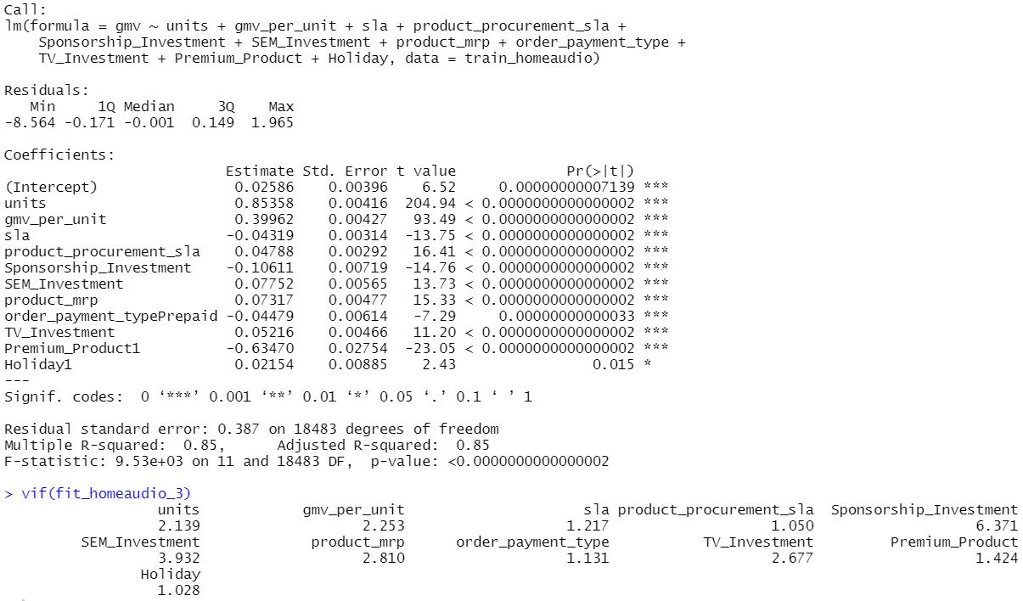
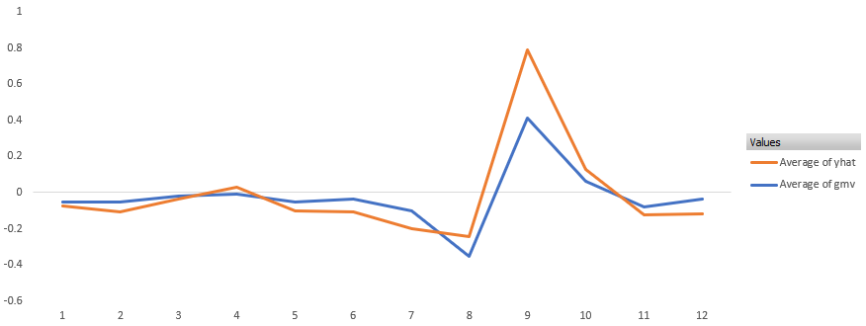
MLR – Home Audio
Model 3
Home Audio
fit_homeaudio_3 = lm(gmv ~ units + gmv_per_unit + sla + product_procurement_sla + Sponsorship_Investment + SEM_Investment + product_mrp + order_payment_type + TV_Investment + Premium_Product + Holiday, data = train_homeaudio)
Model Results:
Comparison of Actuals vs. Predicted (GMV)
Adjusted R Square: 0.85
RMSE : 0.3871

Slide 18
Recommendation – Home Audio
Model 3 Home Audio
fit_homeaudio_3 = lm(gmv ~ units + gmv_per_unit + sla + product_procurement_sla + Sponsorship_Investment + SEM_Investment + product_mrp + order_payment_type + TV_Investment + Premium_Product + Holiday, data = train_homeaudio)
TV Investments has a positive impact on revenue. One dollar investment in TV ads would result in revenue increase of 0.05 dollars
SEM Investment is also working positively for home audio. One dollar investment in SEM would result in revenue increase of 0.077
Sponsorship on the other hand is negatively impacting the revenue. Action step to re-invest sponsorship investment into TV and SEM
Investment
Paste Images from Tableau
Payment Type
&
Holiday
Prepaid type payment in general is good for this category to increase the revenue
Sales are higher during holidays as compared to non-holidays for Home Audio category
Premium pricing is not significant to this category, however, increase in MRP shows a positive impact to increase in revenue but not the extent of entering the premium range. One dollar increase in price would increase the revenue by 0.36 dollars
Price
Notes:
Three Key Points Comparison Text Blanc

Slide 19
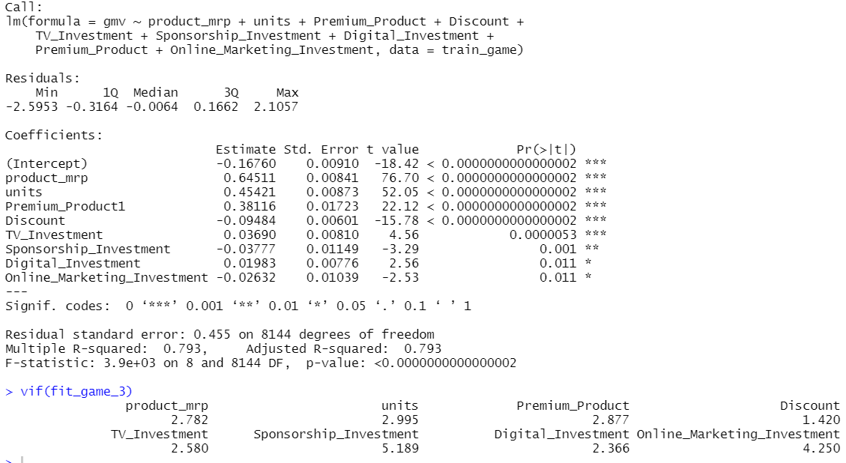
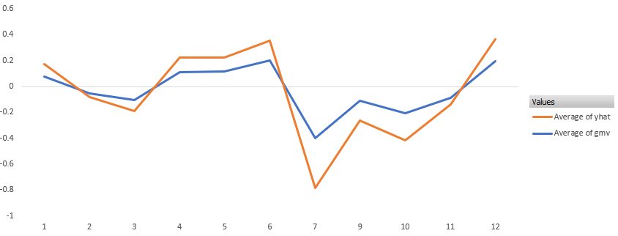
MLR – Game
Model 4
Game
fit_game_3 = lm(gmv ~ product_mrp + units + Premium_Product + Discount + TV_Investment + Sponsorship_Investment + Digital_Investment +Online_Marketing_Investment , data = train_game)
Model Results:
Comparison of Actuals vs. Predicted (GMV)
Adjusted R Square: 0.79
RMSE : 0.455

Slide 20
Recommendation – Game
Model 4 Game
fit_game_3 = lm(gmv ~ product_mrp + units + Premium_Product + Discount + TV_Investment + Sponsorship_Investment + Digital_Investment +Online_Marketing_Investment , data = train_game)
Investment
TV and Digital Investments have positive impact on the revenue whereas Sponsorship and Digital Investments show a negative impact
One dollar investment in TV would increase the revenue by 0.03 dollars and one dollar increase in Digital would increase the revenue by 0.01
Paste Images from Tableau
Premium products are better contributors to increase in revenue as compared to Mass products
Premium Product
Price
&
Discounts
Price is showing a positive impact on the revenue
Higher percentage of Discounts in general given for this sub-category works adversely towards bringing down the revenue
Notes:
Three Key Points Comparison Text Blanc

Slide 21
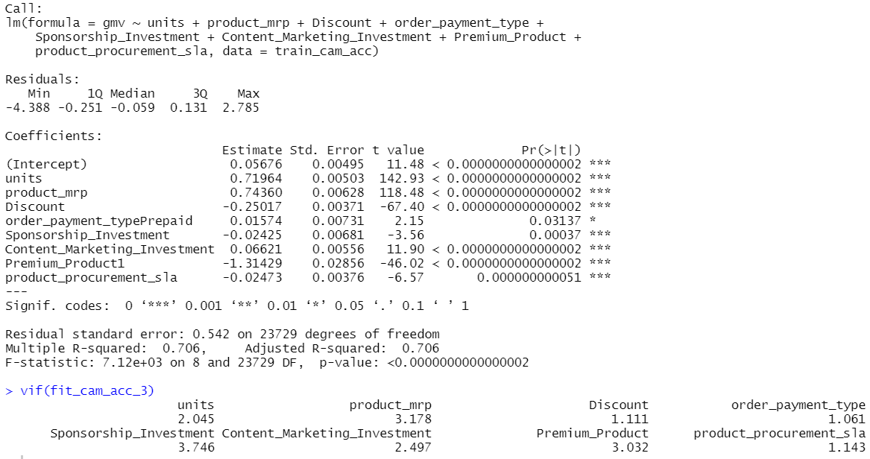
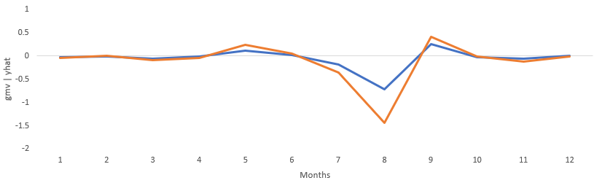
MLR – Camera Accessory
Model 5
Camera
Accessory
fit_cam_acc_3 = lm(gmv ~ units + product_mrp + Discount + order_payment_type + Sponsorship_Investment + Content_Marketing_Investment + Premium_Product + product_procurement_sla , data = train_cam_acc)
Model Results:
Comparison of Actuals vs. Predicted (GMV)
Adjusted R Square: 0.71
RMSE : 0.542

Slide 22
Recommendation – Game
Model 5
Camera Accessory
fit_cam_acc_3 = lm(gmv ~ units + product_mrp + Discount + order_payment_type + Sponsorship_Investment + Content_Marketing_Investment + Premium_Product + product_procurement_sla , data = train_cam_acc)
Investment
Dollars spent on Content Marketing has positive impact on the revenue whereas Sponsorship Investments show a negative impact
One dollar investment on Content Marketing increase the revenue by 0.06 dollars
Paste Images from Tableau
Prepaid payments in general for this sub-category are good in increasing the revenue
Payment Type
Discounts
Higher percentage of Discounts in general given for this sub-category works adversely towards bringing down the revenue.
Notes:
Three Key Points Comparison Text Blanc

